Slide 1
CEN 3078 Computer Security
Module 2 – Application and Network Attacks

Slide 2
TCP fundamental
Attacks on the TCP protocol
Denial-of-Service attack
SQL injection attack
Cross-side scripting attack
Miscellaneous: Heartbleed bug and attack, Ransomware, Cryptojacking
Module 2

Slide 3

The Heartbleed Bug and Attack
Vulnerability in the OpenSSL library, specifically the Heartbeat protocol in TLS (Transport Layer Security)
OpenSSL (widely used library for TLS) drives HTTPS that your web browser relies on for online banking, and other secure transactions
Launched in 2012 on web servers built on top of OpenSSL
Disclosed in 2014
3
Notes:
OpenSSL is a commercial grade toolkit for the TLS/SSL protocols
Many secure web servers are built on top of OpenSSL.
When a client and server are not sending data to each other for a period of time, either side or firewall in between may break the channel.
The protocol:
The sender send a Heartbeat packet to receiver.
Inside the packet there is payload, payload length field. (Actual content of payload is not important)
The receiver constructs a response packet and should carry same payload data as in request.
When the receiver gets a heartbeat request, it retrieves payload length value (n) from the packet, copies n bytes of data to the response packet, starting from the beginning of the payload field in the request packet.

Slide 4
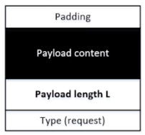
Background: the Heartbeat Protocol
TLS/SSL protocols provide a secure channel between two communicating applications
Heartbeat extension: implement keep-alive feature of TLS
Maintains secure session without interruption (e.g., from firewall) when client and server are not sending data to each other for a period of time
Hard to initiate and re-establish secure sessions
Send request packet to receiver and obtain an acknowledgement packet by doing a copy of the payload content based on payload length L
The copy caused the vulnerability; attacker can specify larger L
Heartbleed bug is an implementation flaw in TLS/SSL heartbeat extension
4
Notes:
OpenSSL is a commercial grade toolkit for the TLS/SSL protocols
Many secure web servers are built on top of OpenSSL.
When a client and server are not sending data to each other for a period of time, either side or firewall in between may break the channel.
The protocol:
The sender send a Heartbeat packet to receiver.
Inside the packet there is payload, payload length field. (Actual content of payload is not important)
The receiver constructs a response packet and should carry same payload data as in request.
When the receiver gets a heartbeat request, it retrieves payload length value (n) from the packet, copies n bytes of data to the response packet, starting from the beginning of the payload field in the request packet.

Slide 5
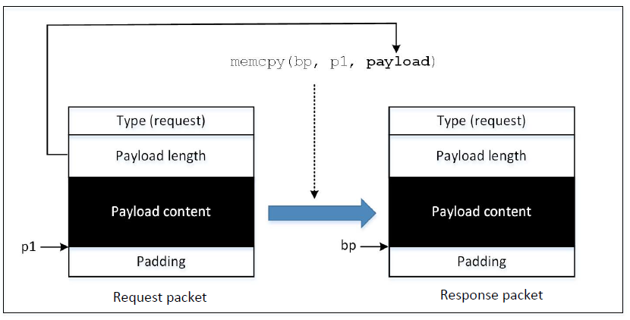
How Response Packet is Constructed
Problem: how much is copied depends on the value contained in the payload length field
What if this value is larger than the actual payload size?
5

Slide 6
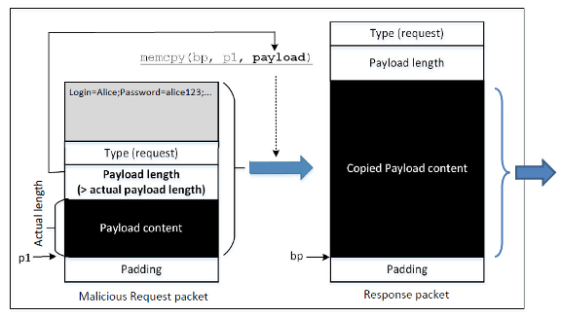
Attack Launch
Attack Results: Some data from the server’s memory also got copied into the response packet, which will be sent out
6
Notes:
To launch a Heartbleed attack, an attacked sends a specially crafted Heartbeat request packet to the victim
Inside this packet, the number put in the payload size field is larger than the actual payload size
When the packet arrives on receiver side, memcpy() will copy more data into the response packet than the request packet.
The affected memory may store sensitive information, such as passwords, credit card info or other user information.
This data will be copied into the response packet and sent to the attacker
By sending a heartbeat request to a vulnerable remote server, attackers can dump the server’s memory and steal sensitive information.

Slide 7
Attack Launch
To launch a Heartbleed attack, an attacked sends a specially crafted Heartbeat request packet to the victim
Inside this packet, the number put in the payload size field is larger than the actual payload size
When the packet arrives on receiver side, memcpy() will copy more data into the response packet than the request packet (i.e., receiver does a memory dump)
The affected memory may store sensitive information, such as passwords, credit card info or other user information
This data will be copied into the response packet and sent to the attacker
By sending a heartbeat request to a vulnerable remote server, attackers can dump the server’s memory and steal sensitive information
7

Slide 8
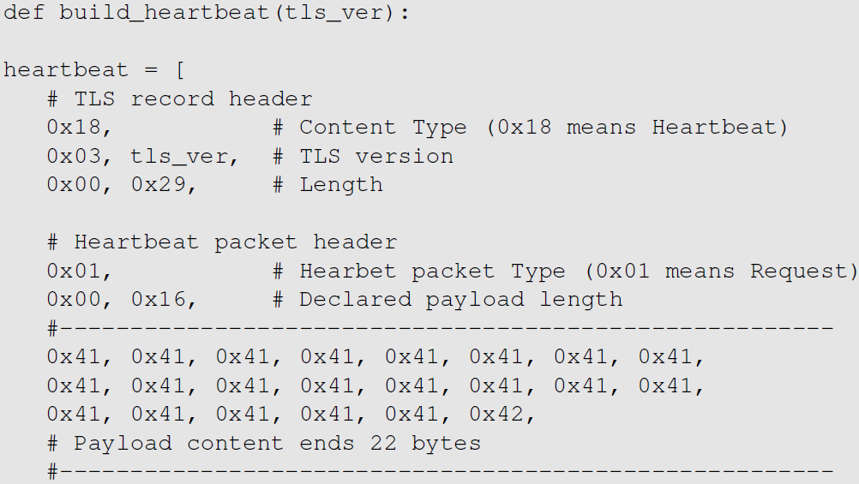
Launch the Heartbleed Attack
0x0016 (22 bytes) is placed in the length field, which exactly matches with the actual length of the payload
We play with this length field to perform our attack in the next slide
From the code snippet we can see that:
TLS record’s size = 0x0029 (not including the record header), which is the size of the payload in the TLS record
The payload contains a Heartbeat request packet, and has its own header (3 bytes) payload (22 bytes) and paddings (16 bytes)
The value 0x0016 is the value that exactly matches with the actual payload (22 bytes), so we will not be able to get any additional data from the server
8
Notes:
Code originally written by Jared Stafforf [Staffoed, 2014].
The attack code constructs a Heartbeat request packet after having established a TLS connection with the target server.
From the code snippet we can see that:
TLS record’s size = 0x0029 (not including the record header), which is the size of the payload in the TLS record.
The payoad contains a Heartbeat request packet, and has its own header (3 bytes) payload (22 bytes) and paddings (16 bytes).
The value 0x0016 is the value that exactly matches with the actual payload, so we will not be able to get any additional data from the server.

Slide 9
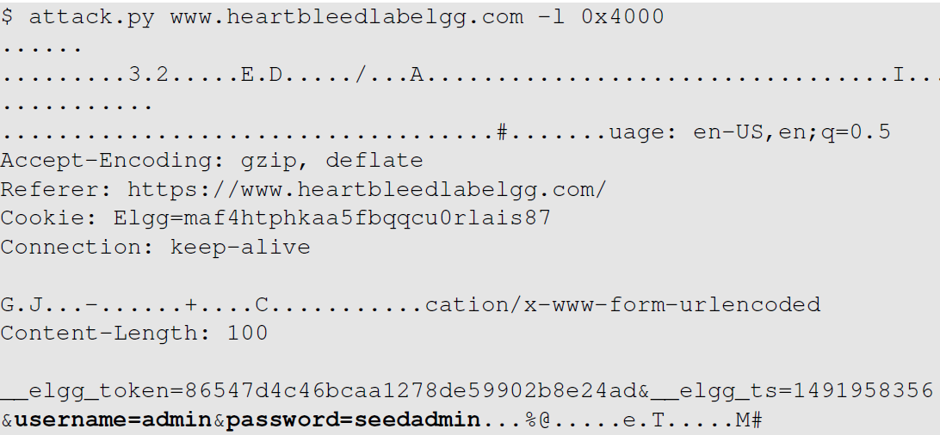
Launch the Heartbleed Attack
We got some secret from the server
We increase this value to higher values (e.g. 0x4000 i.e., 16K; much larger than the actual payload size -> 22 bytes) and start getting larger packets back
The attack.py program prints out the payload data in the response packet
If no user has logged into the server yet before the attack, there will not be much useful data stored in memory
When running the attack multiple times, we may get back different data, because each request packet might be stored at a different memory address
9
Notes:
We increase this value to higher values (e.g. 0x4000 i.e., 16K; much larger than the actual payload size -> 22 bytes) and start getting larger packets back.
The attack.py program prints out the payload data in the response packet.
Analyzing the result:
We find some data return from server like password seedadmin for admin. The admin user has logged into the webserver. Hence, the username and password are still in the memory.
When server constructs the Heartbeat response packet, due to the attack, the server end up sending a lot of data from its memory to the attacker.
If no user has logged into the server yet before the attack, there will not be much useful data stored in memory.
When running the attack multiple times, we may get back different data, because each request packet might be stored at a different memory address.

Slide 10

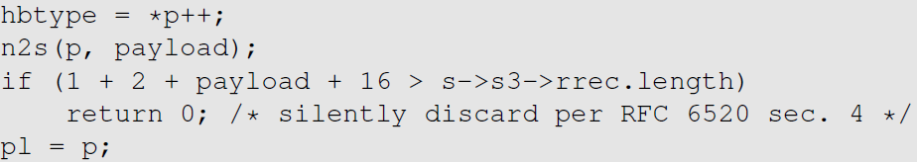
Fixing the Heartbleed Bug
Simply update your system’s OpenSSL library. The following two commands can be used for it:
The following code shows how the OpenSSL library is fixed
10
Notes:
Comparing the shown code with the vulnerable version shown earlier,
An if statement is added
s -> s3 -> rrec.length is the total number of bytes in the request packet; this is the actual length and not the one declared in the request packet.
Constant 1 -> size of type field
Constant 2 -> size of length field
Constant 16 -> minimum padding length
The if statement compares whether the declared payload length plus a constant (19) is larger than the actual size of the request packet.
If larger, the packet is discarded and there will be no reply.
If attacker send a request packet with larger declared length value, the packet won’t have any effect.

Slide 11
Fixing the Heartbleed Bug – Use Bounds Checking
Comparing the shown code with the vulnerable version shown earlier,
An if statement is added
s → s3 → rrec.length is the total number of bytes in the request packet; this is the actual length and not the one declared in the request packet
Constant 1 → size of type field
Constant 2 → size of length field
Constant 16 → minimum padding length
The if statement compares whether the declared payload length plus a constant (19) is larger than the actual size of the request packet
If larger, the packet is discarded and there will be no reply
If attacker send a request packet with larger declared length value, the packet won’t have any effect
Story: Bounds Checking and Game Design
11
Notes:
Comparing the shown code with the vulnerable version shown earlier,
An if statement is added
s -> s3 -> rrec.length is the total number of bytes in the request packet; this is the actual length and not the one declared in the request packet.
Constant 1 -> size of type field
Constant 2 -> size of length field
Constant 16 -> minimum padding length
The if statement compares whether the declared payload length plus a constant (19) is larger than the actual size of the request packet.
If larger, the packet is discarded and there will be no reply.
If attacker send a request packet with larger declared length value, the packet won’t have any effect.

Slide 12
Cryptojacking
Cryptojacking is the unauthorized use (i.e., hijacking) of someone else’s computer processing power to mine cryptocurrency
Hackers do this by either:
Social Engineering / Malware: Getting the victim to click on a malicious link (phishing) in an email that loads cryptomining code (malware) on the computer, or
Browser-based Attacks: By infecting a website or online ad with JavaScript code that auto-executes once loaded in the victim’s browser (mining will take place as long as browser/tab is open)
Either way, the cryptomining code then works in the background as unsuspecting victims use their computers normally
Symptoms: overheating of device, high processor usage, slower performance or lags in execution
12

Slide 13
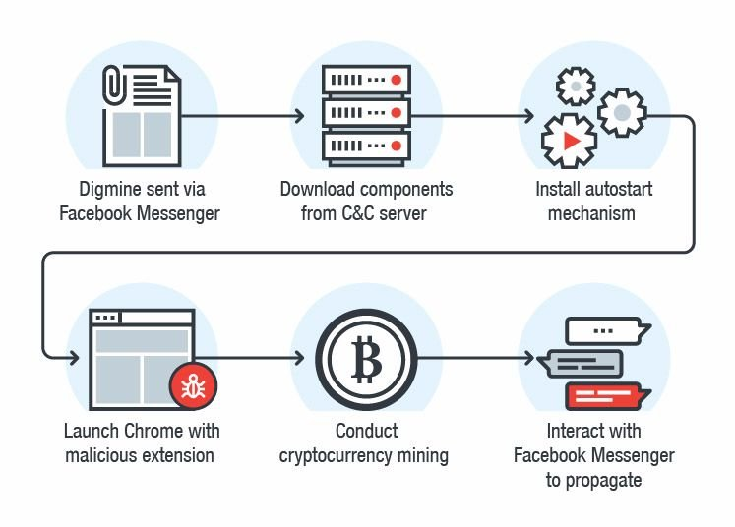
How Cryptojacking Works
Hackers inject a cryptomining script on a website or in an Ad that is placed on multiple sites
When the victim visits the infected website, or if the malicious Ad pops up in the victim’s browser, the script automatically executes
No code is stored on the victim’s computer and no damage is done to computers or victims’ data
Interaction with mining pool
13
Notes:
C&C server : Command and Control server: a computer controlled by an attacker or cybercriminal which is used to send commands to systems compromised by malware and receive stolen data from a target network.

Slide 14
Prevention of Cryptojacking
Use VPN to encrypt internet connections and hide IP address
Awareness and Training to thwart social engineering scams
Install an Ad-blocking or anti-cryptomining extension on web browsers
Use end-point protection that is capable of detecting known crypto miners
Keep your web filtering tools up to date
Maintain browser extensions
Use a mobile device management (MDM) solution to better control what’s on users’ devices
14

Slide 15
DNS and Attacks
DNS Hierarchy, Zones, and Servers
DNS Query Process
DNS Attacks: Overview
Local DNS Cache Poisoning Attack
Defense against DNS spoofing attacks
15

Slide 16
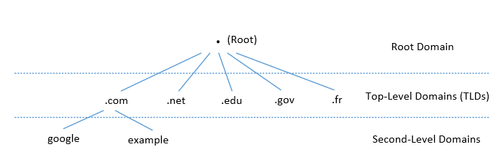
DNS Domain Hierarchy
Domain Name System (DNS) is a phonebook of the Internet – enables mapping of domain names to IP addresses of machines
Domain (nameserver) namespace is organized in a hierarchical tree-like structure
Each node is called a domain, or subdomain.
The root of the domain is called ROOT, denoted as ‘ . ‘
Internet Assigned Name Authority (IANA)
Below ROOT, we have Top-Level Domain (TLD). Ex: In www.example.com, the TLD is .com
The next level of domain hierarchy is second-level domain which are usually assigned to specific entities such as companies, schools etc.
16

Slide 17
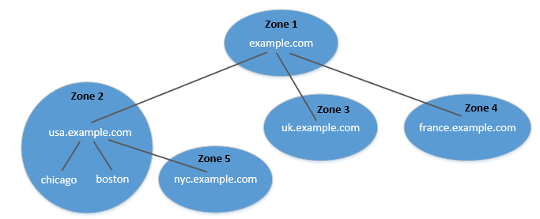
DNS Zone
DNS is organized according to zones
A zone groups contiguous domains and subdomains on the domain tree and assign management authority to an entity
usa.example.com is a domain with subdomains as boston, nyc and chicago; Two zones are created for usa.example.com - First contains usa domain, chicago and boston subdomain and second contains nyc subdomain
Hierarchy tree structure depicts subdomains within example.com domain
In this case, there are multiple DNS zones one for each country; the zone keeps records of who the management authority is for each of its subdomains
For scalability, you have sub-domains on different name servers
17
Notes:
1 zone – if one domain on one nameserver; but in many situations if domain is big and you don’t want to host all on one name server, you can have sub-domains on different name servers – then you have different zones with subsets of sub-domains on different nameservers

Slide 18
Zone vs Domain
A DNS zone only contains a portion of the DNS data for a domain
If a domain is not divided into subdomains, the zone and domain are essentially the same, because the zone contains all the DNS data for the domain
When a domain is big, it is divided into subdomains
Their DNS data can still be put in the same zone, so domain and zone are still the same
But subdomains can have their own zones
18

Slide 19
Authoritative Name Servers
Each DNS zone has at least one authoritative nameserver that publishes information about the zone
It provides the original and definitive answers to DNS queries
An authoritative name server can be a master server (primary) or slave server (secondary)
A master server stores the master copies of all zone records whereas a slave server uses an automatic updating mechanism to maintain an identical copy of the master records
19

Slide 20
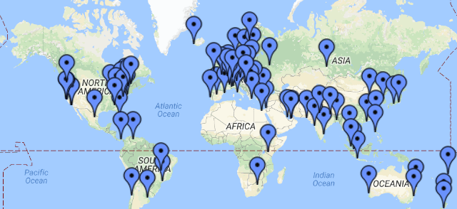
DNS ROOT Servers
The root zone is called ROOT
There are 13 authoritative nameservers (DNS root servers) for this zone
They provide the nameserver information about all top-level domains (TLDs)
https://www.internic.net/domain/root.zone
They are the starting point of DNS queries
20

Slide 21
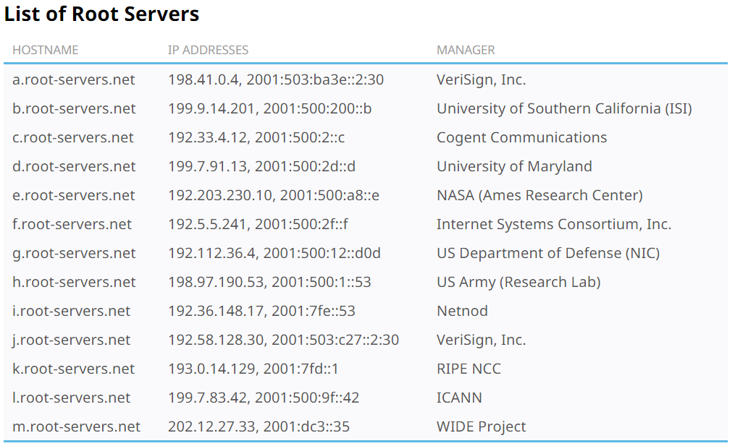
13 DNS Root Servers
They are the most critical infrastructure on the Internet (they mirror the information by having multiple computers at different places in the world – accessible via anycast)
If you can bring down Root servers, the Internet will be down!
21

Slide 22
Top Level Domain (TLD)
Infrastructure TLD: .arpa
Generic TLD (gTLD): .com, .net,
Sponsored TLD (sTLD): These domains are proposed and sponsored by private agencies or organizations that establish and enforce rules restricting the eligibility to use the TLD: .edu, .gov, .mil, .travel, .jobs
Country Code TLD (ccTLD): .au (Australia), .cn (China), .fr (France)
Reserved TLD: .example, .test, .localhost, .invalid
22

Slide 23
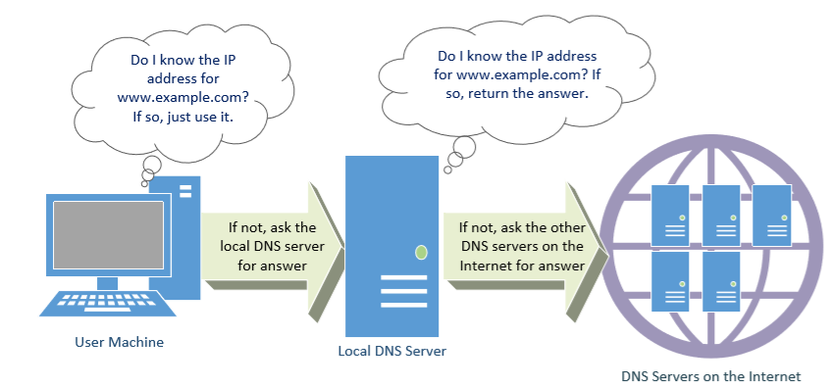
DNS Query Process
DNS Cache
.com
Local DNS Files
Recursive
23
Notes:
DNS query is recursive – keep asking till you find the answer; Let’s ask example.com – talk to com server who has registered the nameserver for the example.com; if you ask that nameserver, if big – then it tell you which sub-domain

Slide 24
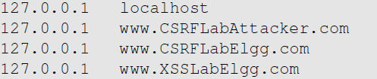
Local DNS Files
/etc/host: stores IP addresses for some hostnames. Before machine contacts the local DNS servers, it first looks into this file for the IP address.
/etc/resolv.conf: provide information to the machine’s DNS resolver about the IP address of the local DNS server. The IP address of the local DNS server provided by DHCP is also stored here.
24
Notes:
Dynamic Host Configuration Protocol

Slide 25
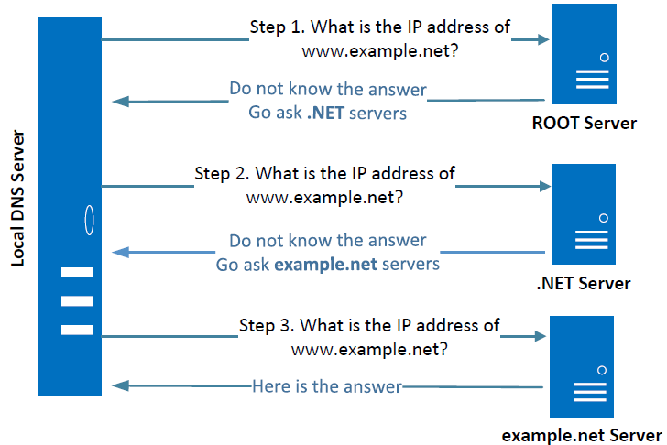
Local DNS Server and Iterative Query Process
The iterative process starts from the ROOT Server
If it doesn’t know the IP address, it sends back the IP address of the nameservers of the next level server (.NET server) and then the last level server (example.net) which provides the answer
25
Notes:
The Local DNS servers need not be local. They may or may not be set up in the local network. Google Public DNS is a DNS service offered by Google, serving any host on the Internet.

Slide 26
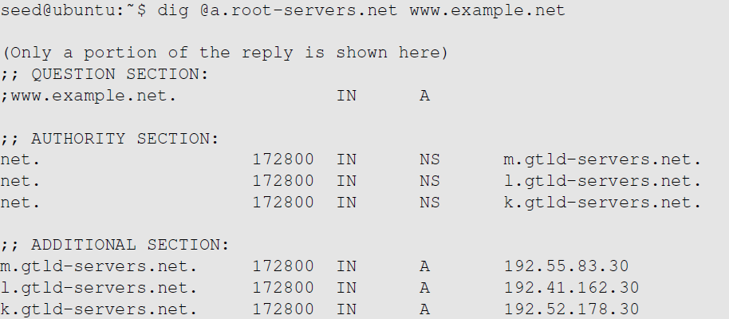
Emulating Local DNS Server (Step 1: Ask ROOT)
Directly send the query to one of the 13 root servers
No answer (the root does not know the answer)
Go ask them!
26
Notes:
If answer section exists, then you have the answer right away – if not go ask them (authority section)

Slide 27
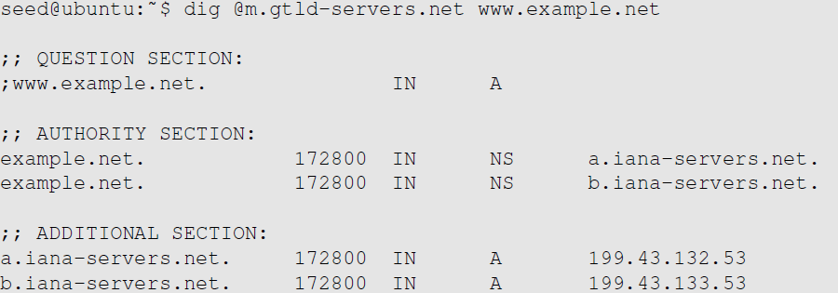
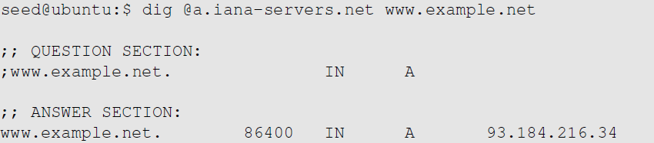

Steps 2-3: Ask .net & example.net servers
Ask a .net nameservers.
Go ask them!
Ask an example.net nameservers.
Finally got the answer
27

Slide 28
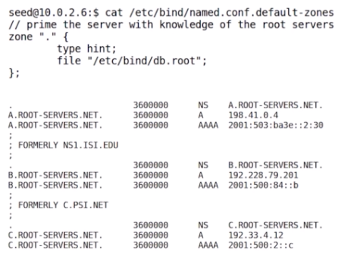
DNS cache
When the local DNS server gets information from other DNS servers, it caches the information
Each piece of information in the cache has a time-to-live value, so it will be eventually time out and removed from the cache
Question: How local DNS server get’s root server IP?
Answer: The Zone file
28

Slide 29
DNS Attacks
Denial-of-Service Attacks (DoS): When the local DNS servers and the authoritative nameservers do not respond to the DNS queries, the machines cannot retrieve IP addresses which essentially cuts down the communication
DNS Spoofing Attacks:
Primary goal: provide a fraudulent IP address to victims, tricking them to communicate with a machine that is different from their intention
Example: If a user’s intention is to visit a bank’s web site to do online banking, but the IP address obtained through the DNS process is attacker’s machine, the user machine will communicate to the attacker’s web server
29

Slide 30
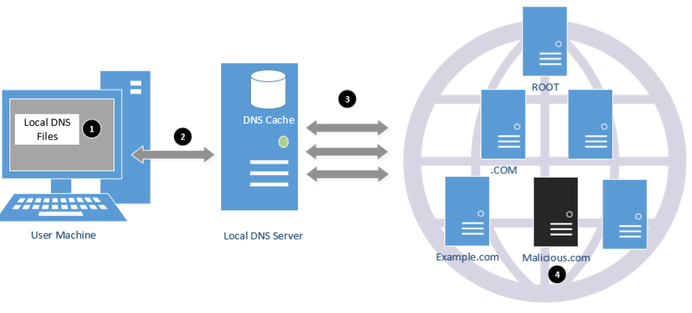
Overview of the Attack Surfaces
DNS queries involve several packets and thus present a broad attack surface in terms of spoofing (1 – 4 in figure below)
/etc/hosts file
with localhost information
You can also launch DoS attack at all points – root, local DNS server, TLD server
30

Slide 31
DNS Attacks on Compromised Machines
If attackers have gained the root privileges on a machine,
Modify /etc/resolv.conf: use malicious DNS server as the machine’s local DNS server and can control the entire DNS process
Modify /etc/hosts: add new records to the file, providing the IP addresses for some selected domains
For example, attackers can modify IP address of www.bank32.com which can lead to attacker’s machine
31

Slide 32
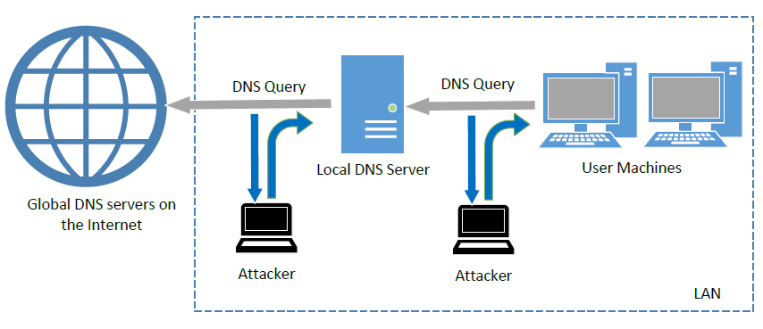
Spoofing DNS Replies (from LAN)
Attacks on user machines : When the user machine sends out a DNS query to its local DNS server, attacker can immediately send a spoofed reply, using local DNS as its source IP address; Attackers can put any arbitrary IP address in the reply
Attacks on local DNS server : Cache Poisoning attack : When the local DNS server sends out iterative queries to get an answer from the DNS servers on the Internet, attackers can send out spoofed replies to the local DNS server; They get accepted as long as they arrive before the actual replies - This is called DNS cache poisoning
32
Notes:
Attacks on user machines : When the user machine sends out a DNS query to its local DNS server, attacker can immediately send a spoofed reply, using local DNS as its source IP address. Attackers can put any arbitrary IP address in the reply.
Attacks on local DNS server : Cache Poisoning attack : When the local DNS server sends out iterative queries to get an answer from the DNS servers on the Internet, attackers can send out spoofed replies to the local DNS server. They get accepted as long as they arrive before the actual replies. This is called DNS cache poisoning.

Slide 33
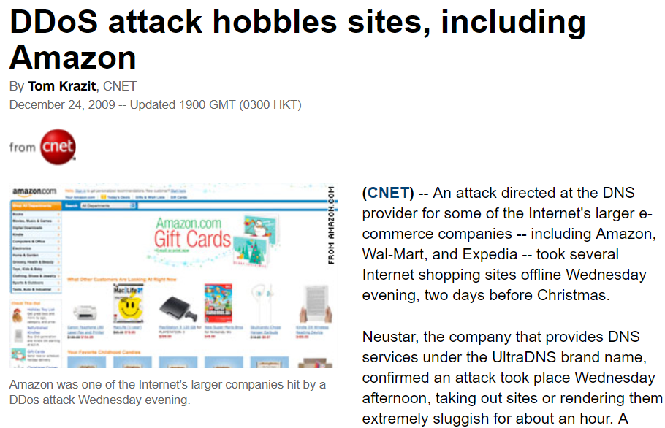
Attacks on Nameservers of a Particular Domain
UltraDNS: DNS provider for many major e-commerce companies such as Amazon, Walmart, Expedia
In 2004, DoS against this UltraDNS provider was launched which suffered an outage for an hour
33

Slide 34
Attacks on Nameservers of a Particular Domain
DNSPod: In 2009, several DNS servers of a Chinese domain service provider were hit by DDoS
The attack was meant to target one particular company (Baofeng.com) which is widely popular video streaming site in China
On the next day of attack, when DNS responses previously cached by the other servers timed out, Baofeng’s media player on users’ machines could not find the IP addresses of the servers because of the attack
Due to the bug in the media player software, instead of waiting, they continuously sent out DNS queries at a faster rate
Due to massive number of DNS queries, they flooded and congested the network of China Telecom (ISP); It impacted 20 provinces and is described as the worst Internet incident in China
34

Slide 35
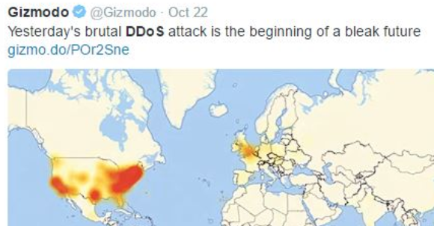
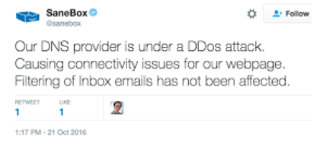
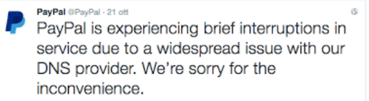
Attacks on Nameservers of a Particular Domain
Dyn network: In 2016, multiple DDoS attacks were launched against a major DNS service provider for companies like CNN, BBC, HBO, PayPal etc. The attacks are believed to have been launched through botnet consisting of different IoT devices like IP cameras, baby monitors etc. It caused major Internet services unavailable
35

